Slide 1
Analyzing natural language feedback using Python
PyDays Vienna
2018
Thomas Aglassinger
V1.0.0

Slide 2

Agenda
About me
What‘s SpaCy?
What sentiment detection?
Collecting restauranteering feedbacks using TeLLers
Jupyter notebook with example analysis

Slide 3
About me
Thomas Aglassinger
Software developer (e-commerce, finance, health)
Master of science in information processing
Co-organizer Python user group Graz: https://pygraz.org
Homepage: http://www.roskakori.at

Slide 4
What is SpaCy?
Natural language processing in Python
Simple to use
Pragmatic algorithms
Fast
However: does not (yet) support sentiment detection
More information: https://spacy.io/

Slide 5
What is sentiment detection?
„systematically identify, extract, quantify, and study affective states and subjective information“ https://en.wikipedia.org/wiki/Sentiment_analysis
Collects opinions from text written in natural language and stores them in a structured way
Different levels:
  Document
  Sentence (possibly multiple per document)
  Aspect (possibly multiple per sentence)

Slide 6
Opinion (de luxe edition)
Example: “The Schnitzel is too small for a hungry student”
(Hans Meier, 2018-04-28, 13:12 UTC)
Consists of:
  Target entity: Schnitzel (popular Austrian food)
  Aspect: size
  Sentiment: bad
  Opinion holder: Hans Meier
  Posting time: 2018-04-28, 13:12 UTC
  Reason: “too small”
  Qualifier: “for a hungry student” → might be find for others
Reference: Bing Liu, “Sentiment Analysis”, Cambridge Press, 2015, p. 22ff

Slide 7
Opinion (simplified)
Example: “The Schnitzel is too small for a hungry student”
(Hans Meier, 2018-04-28, 13:12 UTC)
Consists of:
  Topic: food
  Sentiment: bad
  Opinion holder: Hans Meier
  Posting time: 2018-04-28, 13:12 UTC
Enough to get a grip about
  Pain points
  Unique sales propositions (USP)

Slide 8
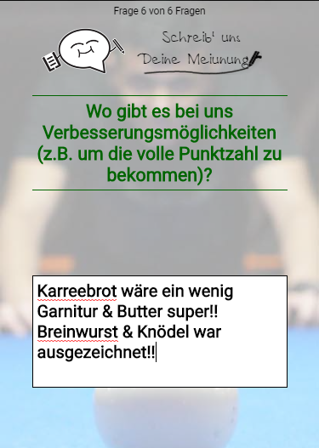
Where to get feedback from?
TeLLers mobile web application
Stores feedback in database
Accessible only by restaurateur
No public publishing on the internet
Austrian startup
https://tellers.co.at/

Slide 9
About the feedback
German language
Textual answers to questions like
  What did you like about your visit?
  What did you like about your visit?
  What can we improve to make your next visit even more pleasant?
  Anything else you want to tell us?

Slide 10
Challenges
Nowadays NLP is mostly about English and Chinese
Limited data
  Region: Graz, Austria
  Time: 6 Months
  Amount: about 1000 feedbacks
Needs old school carefully handmade algorithm
No magic pixie dust of machine learning

Slide 11
Algorithm
Distributed as Jupyter notebook.
Yeah, hardcore!
TODO: Link
Fully executable code and example data
Play around and reuse!
By-product of master‘s thesis

Slide 12
Algorithm – basic pipeline
Replace abbreviations that confuse SpaCy‘s sentence detection
Unify smiley codes and emojis
Replace Austrian slang terms with proper German (surprisingly few)
Split feedback in sentences and tokens (SpaCy)
Extend tokens with information about topic and rating (using a lexicon)
Combine related words, e.g. „nicht besonders gut“ (=“not particularly great“ = somewhat bad)
Reduce sentence to single topic and rating

Slide 13
Summary
Lexicon based sentiment detection on a sentence level can be implemented comparably easily using SpaCy as base
Manual pre-analysis of existing data required
„good enough“ result to identify areas of interest

